Slide 1
DEPLOYMENT AUTOMATION
ANIRUDH CHAUDHARY
500061147
R171217008

Slide 2
WHAT IS DEPLOYMENT?
Each and every time, an application is installed for testing, it requires a deployment. During the testing process, the overall quality of the application is verified and so, the rollout time is important. The newer version of the deployment is initially rolled out to a subset of the production environment and monitored for performance and feedbacks before it is completely rolled out.

Slide 3
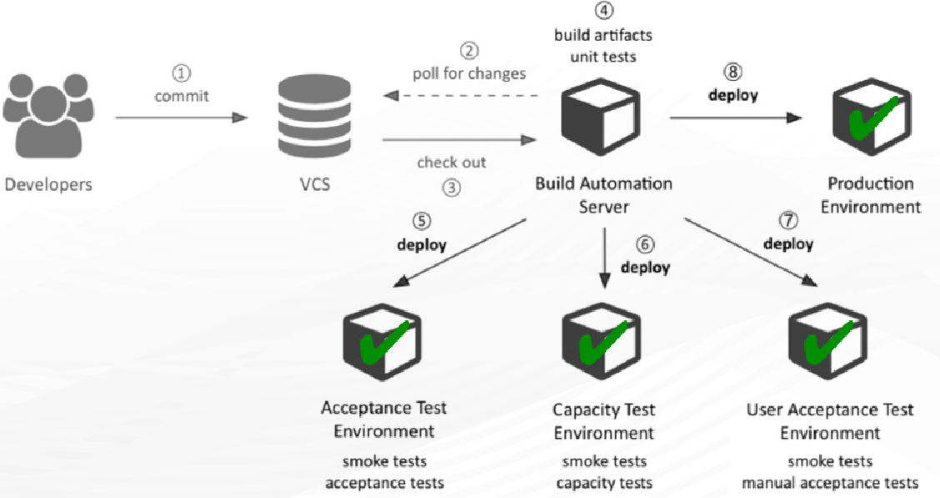
DEPLOYMENT OVERVIEW

Slide 4
DEPLOYMENT IMPLICATIONS
Installing applications
Updating applications
Configuring middleware components
Configuring the installed application
Configuration systems
Verification of components
Scaled to the enterprise

Slide 5
WHY AUTOMATED DEPLOYMENT?
Providing a new functionality is always a traditional clashing point between development and operations as operations is accountable for continuity which leads to lots of confusion and conflict.
Also ,the traditional deployment method is very unreliable where one or more team members must manually copy files, edit configuration values, remote desktop to servers, restart services, synchronize folders, and apply database changes.

Slide 6
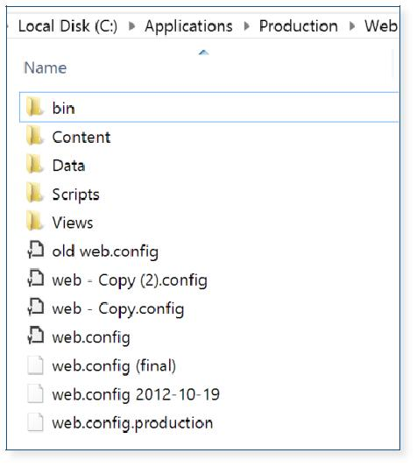
MANUAL DEPLOYMENT SETBACKS
Outdated and extensive documentation is required
Affects collaboration between teams
Inconsistency (HUMAN ERROR)
Slow deployment
Not repeatable or reliable

Slide 7
DEPLOYMENT AUTOMATION REQUIREMENTS:
The system must support packages, environments and bindings, which are important for any deployment.
The system should support middleware systems.
Irrespective of the role, developers, administrators or deployment personnel should be able to use the tool with ease.
The system must have the ability to scale, to accommodate many applications that have many users.
There must be cross-platform support.

Slide 8
BENEFITS OF DEPLOYMENT AUTOMATION
Cost Effective & Repeatable -Activities reusable over and over again
Fast - Full deployments with a press of a button
Transparent, Informative & Accessible - Deployments with full transparency and informative
Consistent -Subsequent deployments identical over time
Scalable -Deployment patterns can be applied to many environments over time

Slide 9

IMPACT OF DEPLOYMENT AUTOMATION
Time taken to deploy (production), manual vs. automated
P E R C % E N T
50
40
30
20
10
0
A few minutes 15 minutes 30 minutes 1 hour 2-3 hours 4-8 hours Even longer
Manual
Automated

Slide 10
Automated Deployment and DevOps
Deployment automation allows us to think infrastructure as code, thus the entire deployment process becomes an engineering task, that the development teams can focus on. This brings the development and operation teams together to define and plan the tasks, even before any iteration begins.
Once an iteration commences, the respective teams carry out the tasks and demonstrate to the customer. Then the teams sit together and brainstorm on the feedback and ways for improvement. By this, the teams always have the deployable code and working software at the end of each iteration.
User feedback is received at frequent intervals and in early stages. Deployment automation also helps in developing and maintaining software in a lean way, with the features that the users want.

